Slide 1

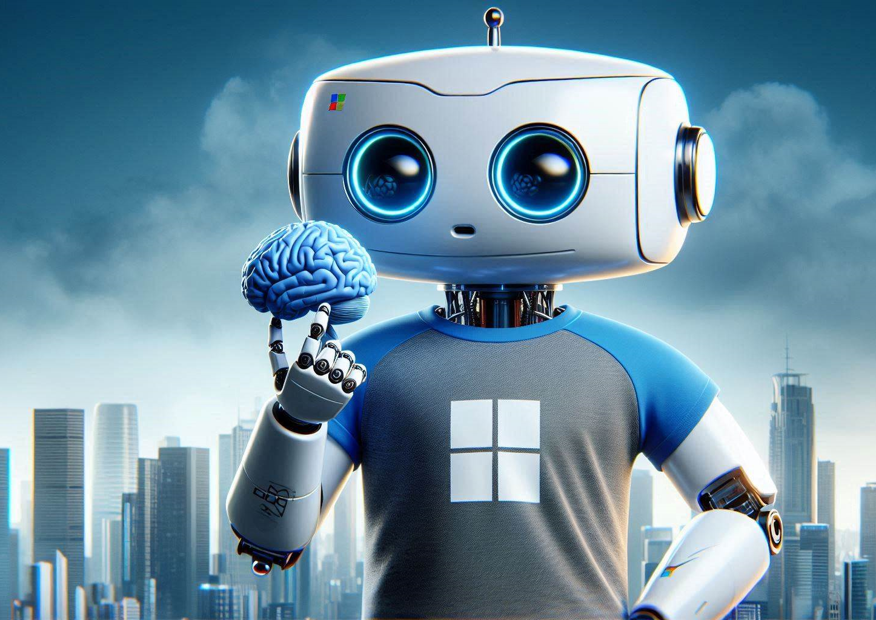
Getting started with Azure AI Studio

Slide 2
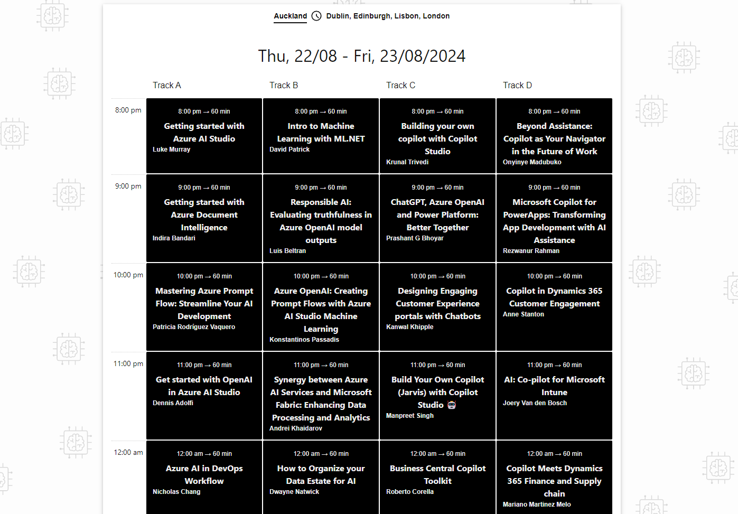
wedoAI 2024
https://wedoai.ie/

Slide 3




Hello!
Thank you for joining us today
Speaker: Luke Murray
Senior Consultant, , , New Zealand
Microsoft Azure MVP from Hamilton, New Zealand
https://x.com/lukemurraynz
https://www.linkedin.com/in/ljmurray/
https://luke.geek.nz/

Slide 4


Slide 5
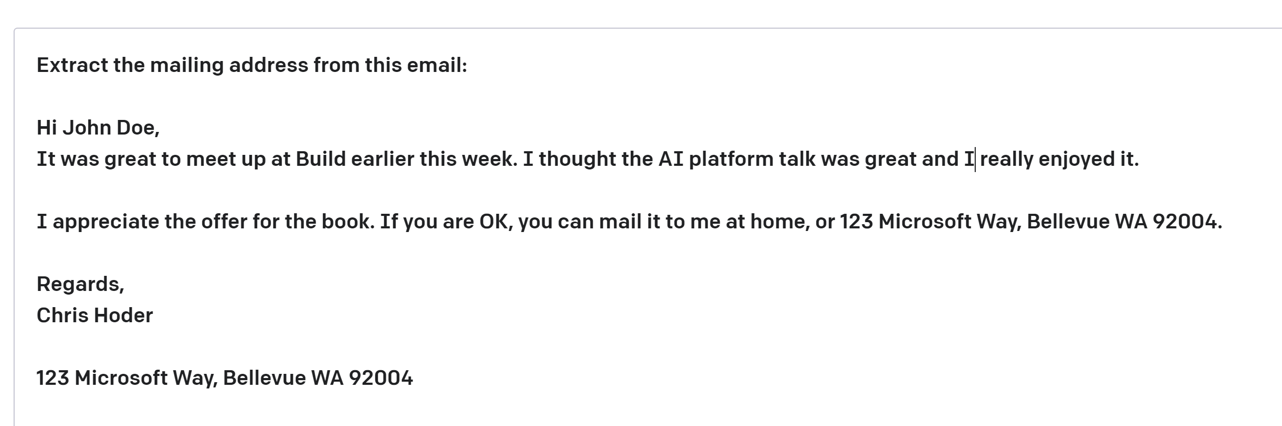
| OpenAI Key Terms
some context
Prompt—Text input that provides some context to the engine on what is expecting.
Completion—Output that GPT-3 generates based on the prompt.
Token — partial or full words processed and produced by the GPT models
https://learn.microsoft.com/en-us/legal/cognitive-services/openai/transparency-note

Slide 6
Using prompts to get completions from models
Task | Prompt | Completion
Classifying content | Tweet: I enjoyed the training course. Sentiment: | Positive
Generating new content | Write a poem about databases | Databases, oh databases, You keep our information safe, From the small to the large, You store our data in a place.
Transformation/Translation | English: Hello French: | Bonjour
Summarization | Scotland is [long description of Scotland…] Summarize the previous text | Scotland is [summarized description…]
Continuation | One way to grow tomatoes is to | start with seeds…
Question answering | How many moons does Earth have? | Earth has one moon.
Chat | Setup, followed by messages… | A sequence of relevant responses

Slide 7
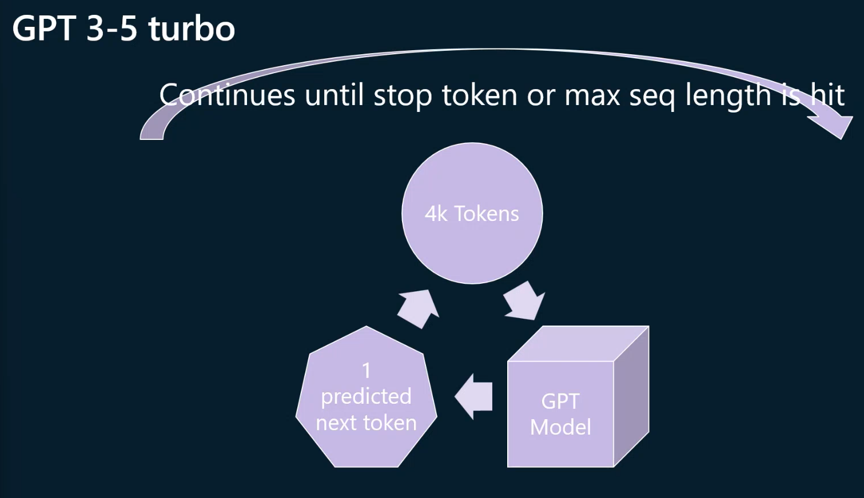

Slide 8
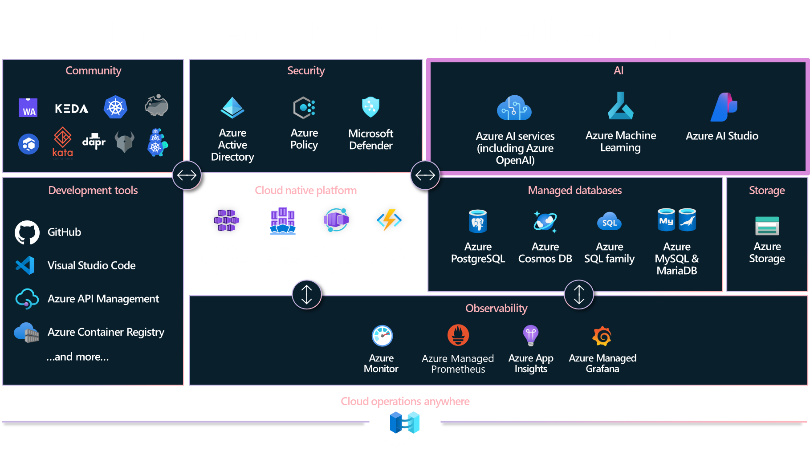

Slide 9


Azure AI Studio
Generally available
https://ai.azure.com

Slide 10
AI safety and security
Copilot Studio
Microsoft Copilot
Your copilots
Microsoft apps
Copilot Stack
AI orchestration
Your data
Foundation models & AI toolchain
AI infrastructure
Microsoft Cloud

Slide 11
Battle of the Studios
Feature | Azure AI Studio | Copilot Studio
Purpose | Provides everything needed to build AI solutions | A generative AI tool integrated with Microsoft 365 and productivity apps
Infrastructure | Requires building the infrastructure and code | No need to build infrastructure or code
Data | Requires providing data and training the model | Uses content already available in your tenant
Functionality | Can become an expert in a particular subject and provide valuable insights | Limited to natural language processing
Use Case | Ideal for creating customized AI solutions | Helps knowledge workers with their day-to-day activities
“Please note that while both tools use AI, they are not interchangeable and have different use case, Azure AI Studio is more about building customized AI solutions, while Copilot Studio is about assisting users in their day-to-day activities.”

Slide 12
Azure AI Studio (2)
Azure AI Studio
A unified platform for developing generative AI apps and custom copilot experiences
Unified platform
Comprehensive AI Tools
Code-centric Developer experiences
Data & search
Data integration
Hybrid vector search
Foundation models
Best in class and open model catalog
Multimodal
Safe & responsible AI
Content classification
Model monitoring
Jailbreak risk detection
Full development lifecycle
Prompt flow
LLMOps
Model monitoring
Explore, build, evaluate, and deploy AI responsibly

Slide 13
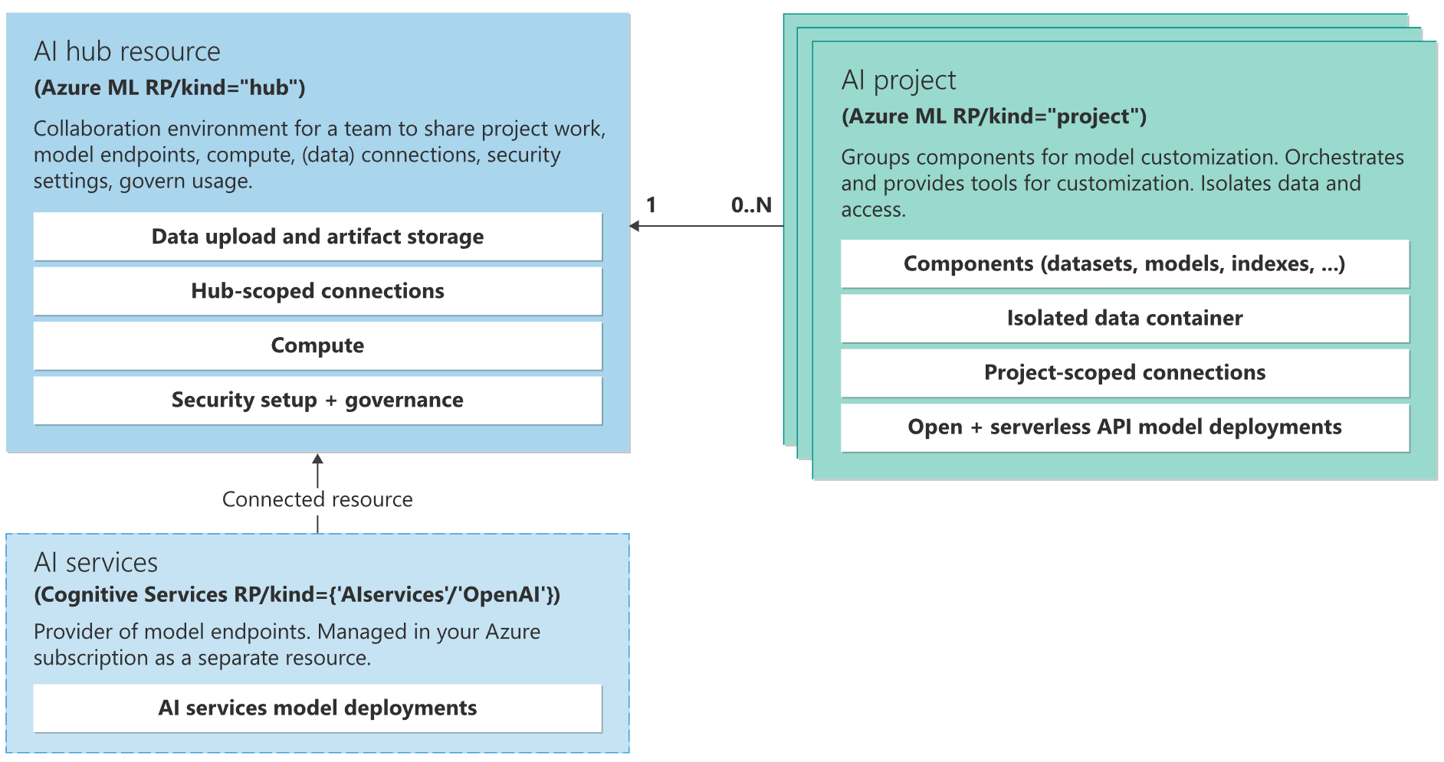
Azure AI Studio (2)
Azure AI Studio
A unified platform for developing generative AI apps and custom copilot experiences
Unified platform
Comprehensive AI Tools
Code-centric Developer experiences
Data & search
Data integration
Hybrid vector search
Foundation models
Best in class and open model catalog
Multimodal
Safe & responsible AI
Content classification
Model monitoring
Jailbreak risk detection
Full development lifecycle
Prompt flow
LLMOps
Model monitoring
Explore, build, evaluate, and deploy AI responsibly

Slide 14
Demo – Introduction to Azure AI Studio
Luke Murray

Slide 15
Azure AI Studio (3)
Azure AI Studio
A unified platform for developing generative AI apps and custom copilot experiences
Unified platform
Comprehensive AI Tools
Code-centric Developer experiences
Data & search
Data integration
Hybrid vector search
Foundation models
Best in class and open model catalog
Multimodal
Safe & responsible AI
Content classification
Model monitoring
Jailbreak risk detection
Full development lifecycle
Prompt flow
LLMOps
Model monitoring

Slide 16

Data is the fuel that powers AI

Slide 17
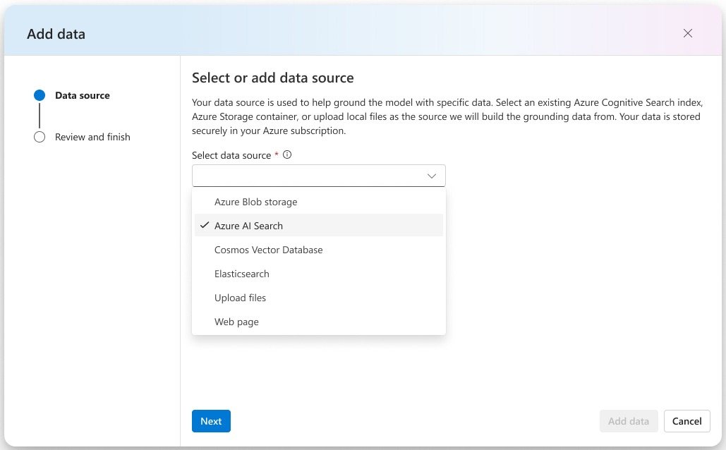
Integrate structured & unstructured data
Blob storage
Azure Data Lake (ADLS)
Fabric OneLake
Local files/folders
S3 via OneLake shortcut
Azure AI Search
… countless others

Slide 18
Vector Search in Azure AI Search
General availability
Powerful information retrieval for generative AI applications

Slide 19
Think of vectors as a way to represent data using numbers. In simple terms, a vector is a list of numbers. Each number in the list represents a specific feature or characteristic of the data we're looking at.
Example:
Imagine you have a list of numbers that represent a fruit:
Color (Red = 1, Green = 2, Yellow = 3)
Size (Small = 1, Medium = 2, Large = 3)
Sweetness (Not sweet = 1, Sweet = 2, Very sweet = 3)
If you have an apple, you might represent it as:
Color: Red (1)
Size: Medium (2)
Sweetness: Sweet (2)
So, the vector for this apple would be: [1, 2, 2]

Slide 20
Azure AI Search: vectors + keywords + re-ranking
Percentage of queries where high-quality chunks are found in the top 1 to 5 results, compared across search configurations. All retrieval modes used the same set of customer query/document benchmark. Document chunks were 512 tokens with 25% overlap. Vector and hybrid retrieval used Azure OpenAI Ada-002 embeddings.
Azure AI Search: Outperforming vector search with hybrid retrieval and ranking capabilities – Microsoft Community Hub

Slide 21
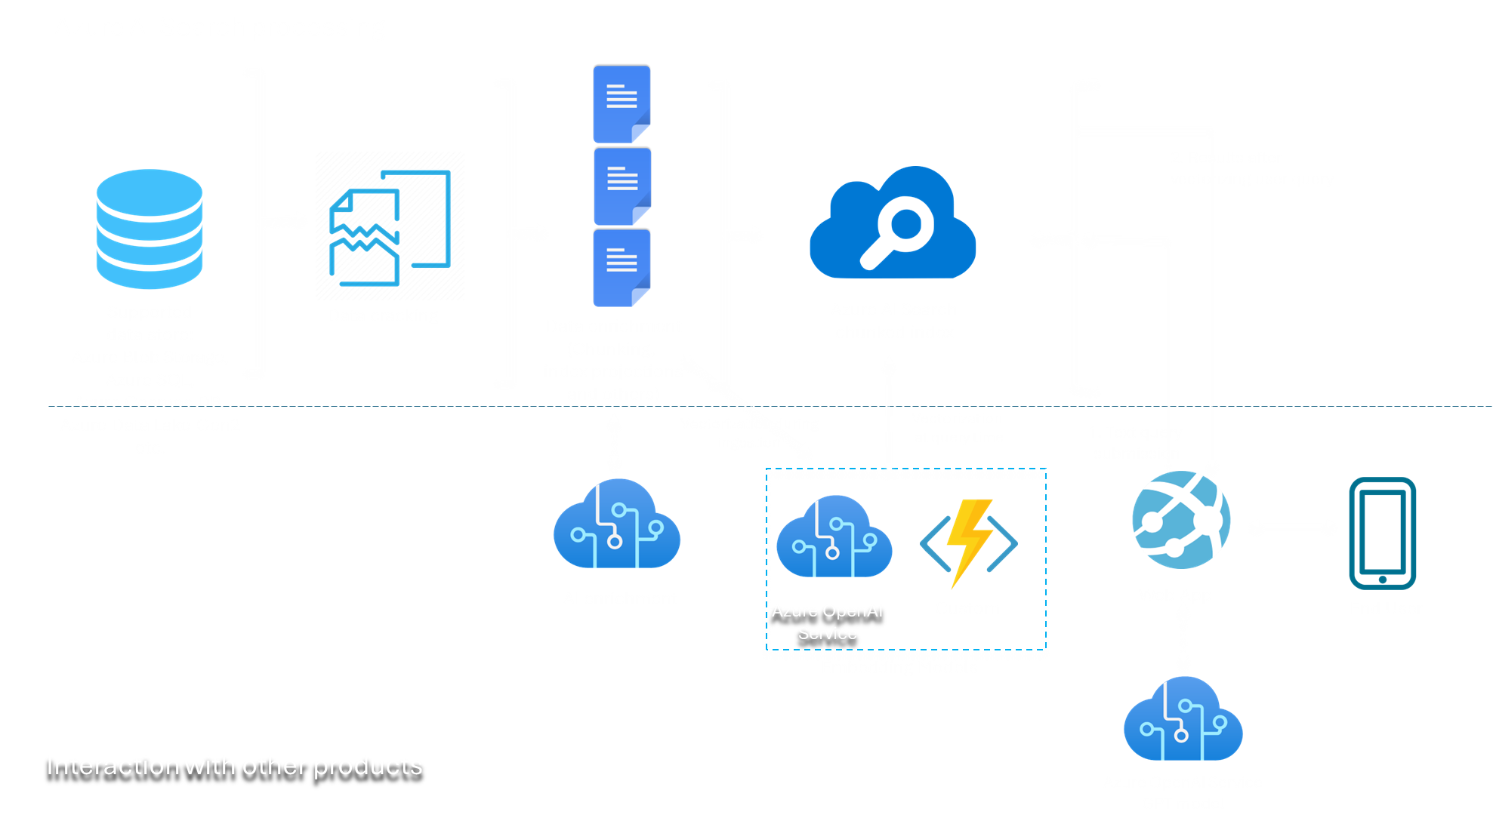
Introducing Integrated Vectorization Visualization End-to-end data ingestion, chunking, vectorization, and advanced retrieval

Slide 22
Demo – Add your own data
Luke Murray

Slide 23
Azure AI Studio
A unified platform for developing generative AI apps and custom copilot experiences
Unified platform
Comprehensive AI Tools
Code-centric Developer experiences
Data & search
Data integration
Hybrid vector search
Foundation models
Best in class and open model catalog
Multimodal
Safe & responsible AI
Content classification
Model monitoring
Jailbreak risk detection
Full development lifecycle
Prompt flow
LLMOps
Model monitoring

Slide 24

Latest Azure OpenAI Service models
Announcing
Preview
Assistants API
Preview
gpt-4o
Preview
DALL·E-3
Preview
Assistants API
Preview
Fine-tuning for GPT-4

Slide 25
Azure OpenAI Service
GPT-4 Turbo with Vision
&
GPT-4o
Enable multimodal GenAI with video, image, and text
Unlock new scenarios with integrated Azure AI Vision support
Augment RAG pattern with images and Azure AI Search

Slide 26
Azure AI
Your data is your data
Your data is not used to train the foundation AI models
Build on trust
Your data is protected by the most comprehensive enterprise compliance and security controls

Slide 27
Fine-tune your Azure OpenAI models
Announcing
Fine-tuning for
GPT-3.5 Turbo
Fine-tuning for GPT-4
Preview
Assistants API
Preview
Fine-tuning for GPT-4

Slide 28
RAG vs Fine-tuning
Adding knowledge, modifying tone and format

Slide 29

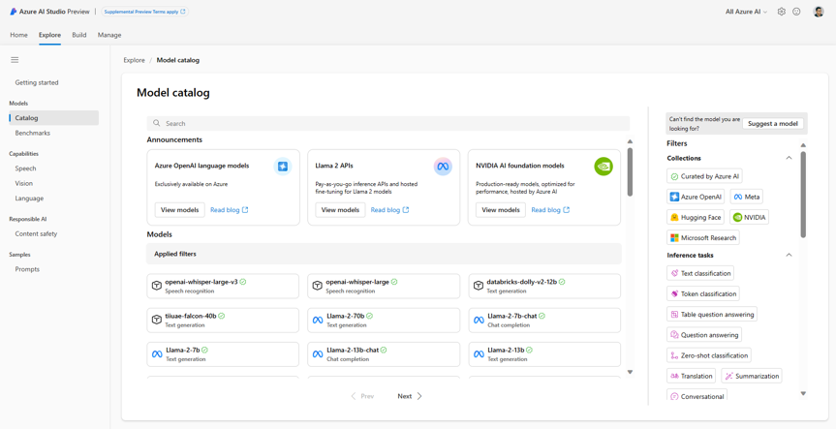
Model catalog: quality and quantity
Azure OpenAI GPT-4, GPT-4 Turbo, GPT 3.5, ChatGPT, DALL-E
Deploy & fine tune on your infra Curated by Azure AI: Phi-2, Falcon, Databricks Dolly-v2, Stable Diffusion, and more Hugging Face: 1000s of OSS models

Slide 30
Models as a Service
Launching soon with Meta’s Llama 2, Mistral’s premium models, G42’s Jais, Cohere’s Command
Ready-to-use API with pay-as-you go billing based on tokens for LLMs
Integrate with your favorite LLM tools like prompt flow, Semantic Kernel, and LangChain
Hosted fine-tuning without provisioning GPUs
Announcing

Slide 31
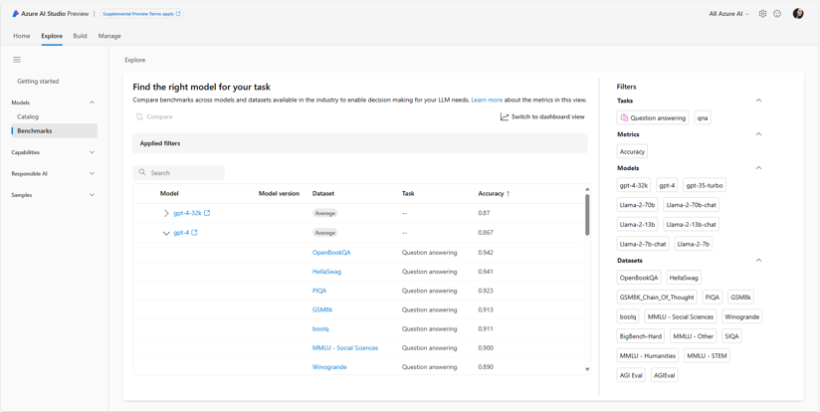
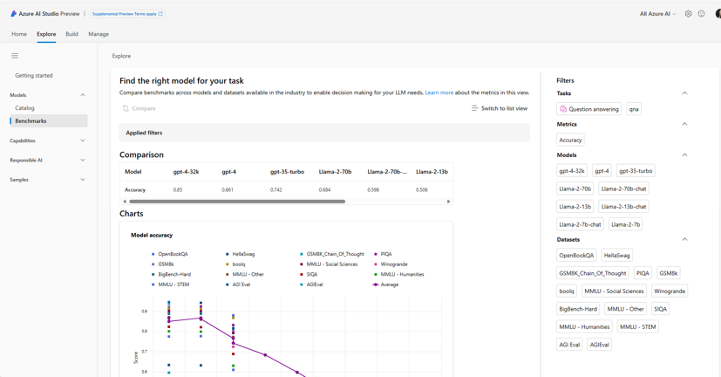
Model benchmarking
Announcing
Model benchmarks will offer users a comprehensive comparison view for benchmarking metrics of foundation models in the model catalog
This will allow users the opportunity to self-educate and make informed decisions about the sustainability of models and datasets prior to initiating any job

Slide 32
Assistants Stack
Apps
Microsoft Copilot Extensibility
Microsoft Copilots
+ your copilots
Copilots
AI orchestration
Instructions (Meta Prompt)
Built-in safety system
and responsible AI
tools
Function Calling
Assistant
Tools
Code Interpreter
Azure OpenAI
Assistants API
Knowledge Retrieval
Foundation models
AI infrastructure

Slide 33
Demo – MaaS
Luke Murray

Slide 34
Azure AI Studio
A unified platform for developing generative AI apps and custom copilot experiences
Unified platform
Comprehensive AI Tools
Code-centric Developer experiences
Data & search
Data integration
Hybrid vector search
Foundation models
Best in class and open model catalog
Multimodal
Safe & responsible AI
Content classification
Model monitoring
Jailbreak risk detection
Full development lifecycle
Prompt flow
LLMOps
Model monitoring

Slide 35
Microsoft’s responsible AI principles
Fairness
Reliability
& safety
Privacy &
security
Inclusiveness
Transparency
Accountability

Slide 36
Responsible AI innovation
Office of Responsible AI
Cross-company governance and coordination
Research
Cutting-edge research and thought leadership
Policy
Excellence in policy, governance, and enablement
Engineering
Best-in-class
engineering systems and tools
Customer signal
Customer Success and Support teams, Engineering, Sales, Marketing, Partners

Slide 37
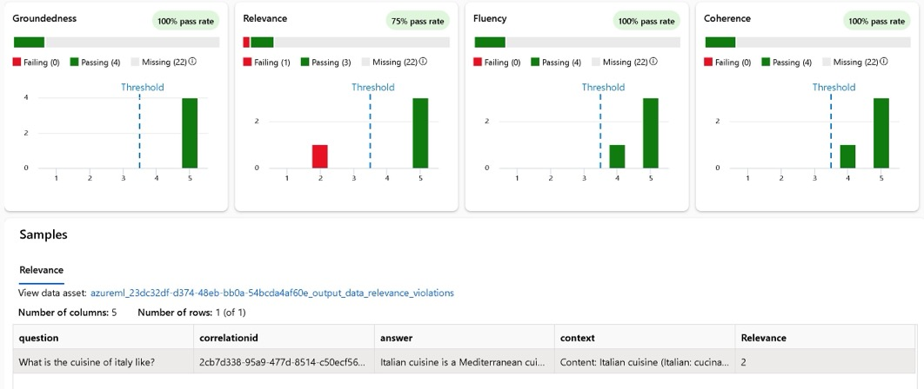
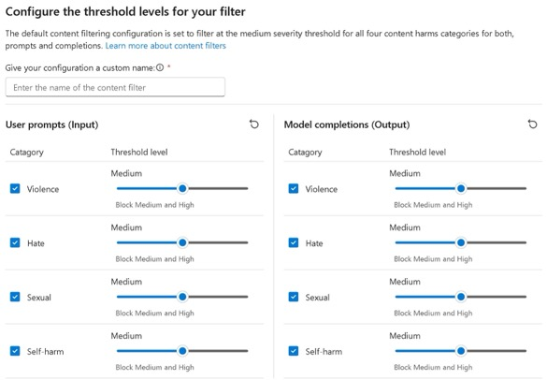
Pioneering new engineering tools and practices
Evaluation and RAI dashboard
Content safety

Slide 38
Azure AI Studio
A unified platform for developing generative AI apps and custom copilot experiences
Unified platform
Comprehensive AI Tools
Code-centric Developer experiences
Data & search
Data integration
Hybrid vector search
Foundation models
Best in class and open model catalog
Multimodal
Safe & responsible AI
Content classification
Model monitoring
Jailbreak risk detection
Full development lifecycle
Prompt flow
LLMOps
Model monitoring

Slide 39
Prompt flow
General availability
Streamline prompt orchestration for AI applications

Slide 40
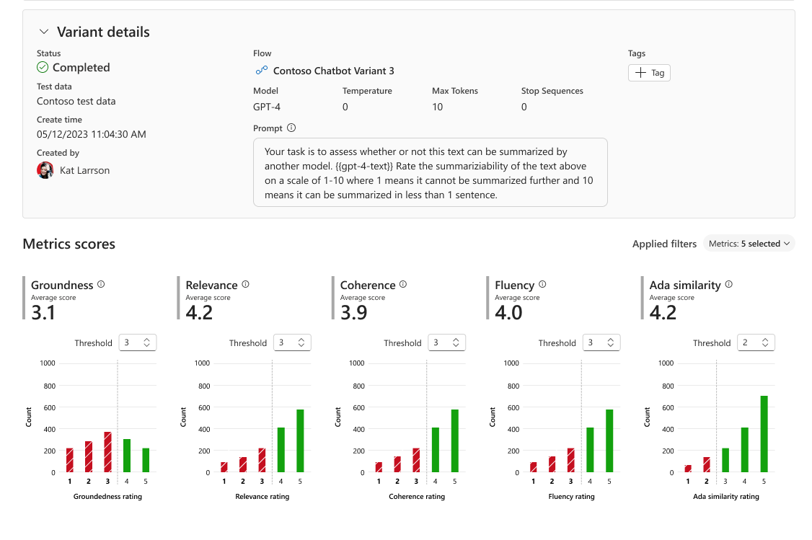
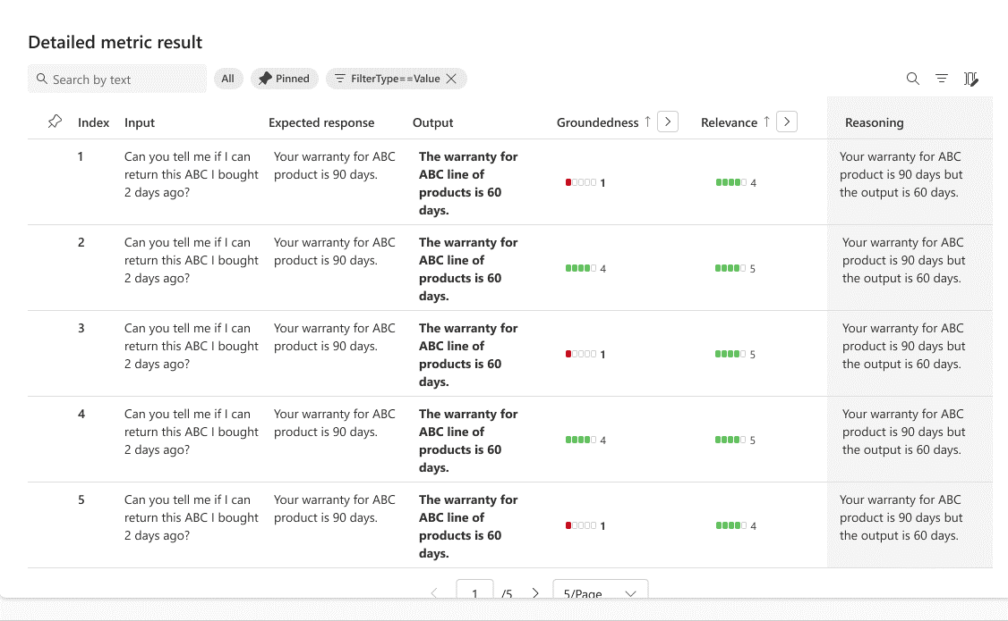
Tools for evaluation
Orchestrate existing APIs, data stores, and models
Evaluate capabilities, cost, latency, & compatibility

Slide 41
Extending AI Studio to the edge
Simplifies the generative AI app development experience on local Windows Devices
Brings together cutting-edge AI development tools and a model catalog
Developers can finetune, customize, and deploy small language models (SLMs) all in one place
Available in preview as a VS code extension today
Coming soon
https://aka.ms/WindowsAI-Studio​

Slide 42
Demo – Prompt flow
Luke Murray

Slide 43
Get started skilling with AI on Microsoft Learn
Build AI skills, connect with the community, earn Microsoft Credentials, learn from experts, and take the Cloud Skills Challenge.
aka.ms/LearnAtAITour

Slide 44
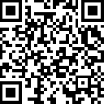
Join the Azure AI Community on Discord
Connect with fellow enthusiasts, engage with Microsoft experts and MVPs, discuss your favorite sessions, and delve into AI discussions. Your space to ask, share, and explore!
aka.ms/AzureAI/Discord

Slide 45
Azure OpenAI Service-Learning Guide
Create an Azure subscription
Apply for access to the Azure OpenAI Service: https://aka.ms/oai/access )
Watch the video: An Introduction to Azure OpenAI
Get Familiarized with the product content: Azure OpenAI Page
Review how other customers are using Azure AI
How-to guides: Generate embeddings and Fine-tune
Complete embeddings and document search tutorial.
How your/your customer data is processed, used and stored in Azure OpenAI: Data, privacy and security
Review the Enterprise Data with ChatGPT tech blog, and work through the accompanying GitHub repository.
Become familiar with the APIs
Basic
Advanced
Start Here!
Intermediate
Learn more in the Azure OpenAI WorkshopI
See examples in the Open AI Cookbook
Start experimenting and developing your MVP
Get support and help
Understand “What is Azure OpenAI?”: compare Azure OpenAI and OpenAI. Review key concepts.
Work through Introduction to Azure OpenAI Service training module
Explore key Responsible AI guidelines and principles

Slide 46
Thank you

Slide 47
Azure. Limitless innovation.

Slide 48












Prompt
Answers
Question
Context Analysis
Transformer Model
Reasoning
Information Extraction
Chat
Tokenizer
Tokenizer
Zero shot
Object Recognition
Few shot
Attention
Weightings
Vector
Follow Instruction

Slide 49
















Azure AI
Applications
Partner Solutions
Business Users
Application Platform
AI Builder
Power BI
Power Apps
Power Automate
Power Virtual Agents
Scenario-Based Services
Applied AI Services
Bot Service
Cognitive Search
Form Recognizer
Video Indexer
Metrics Advisor
Immersive Reader
Customizable AI Models
Azure OpenAI
Service
Cognitive Services
Developers & Data Scientists
Vision
Speech
Language
Decision
ML Platform
Azure Machine Learning

